Slide 1

Medical Store Inventory System
Presented by Intelliware: Amaar 22i-0759, Saad 22i-1030, and Mustafa 22i-1139
ak
by amaar khan

Slide 2

Project Introduction
Key Goals
Core Features
Efficient stock, automated transactions, reduce expiries
Solution Overview
Inventory, sales, reporting with secure user interface
Python & Flask web app for medical store management

Slide 3
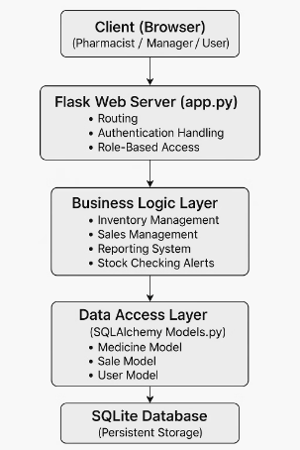
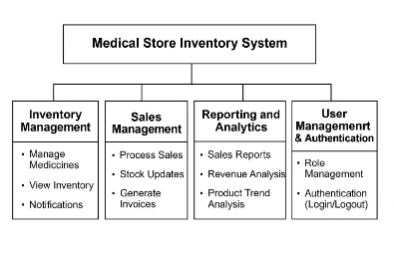
UML Diagrams
Architecture Diagram
Package Diagram

Slide 4
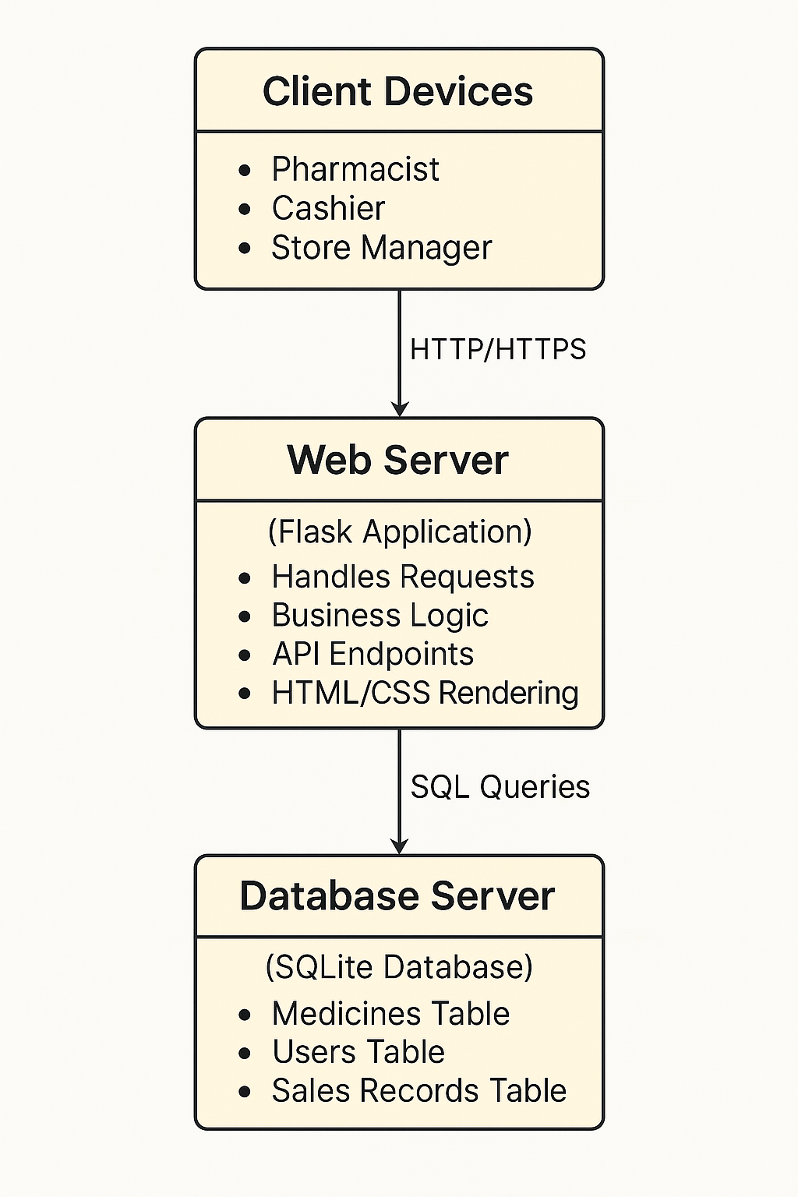
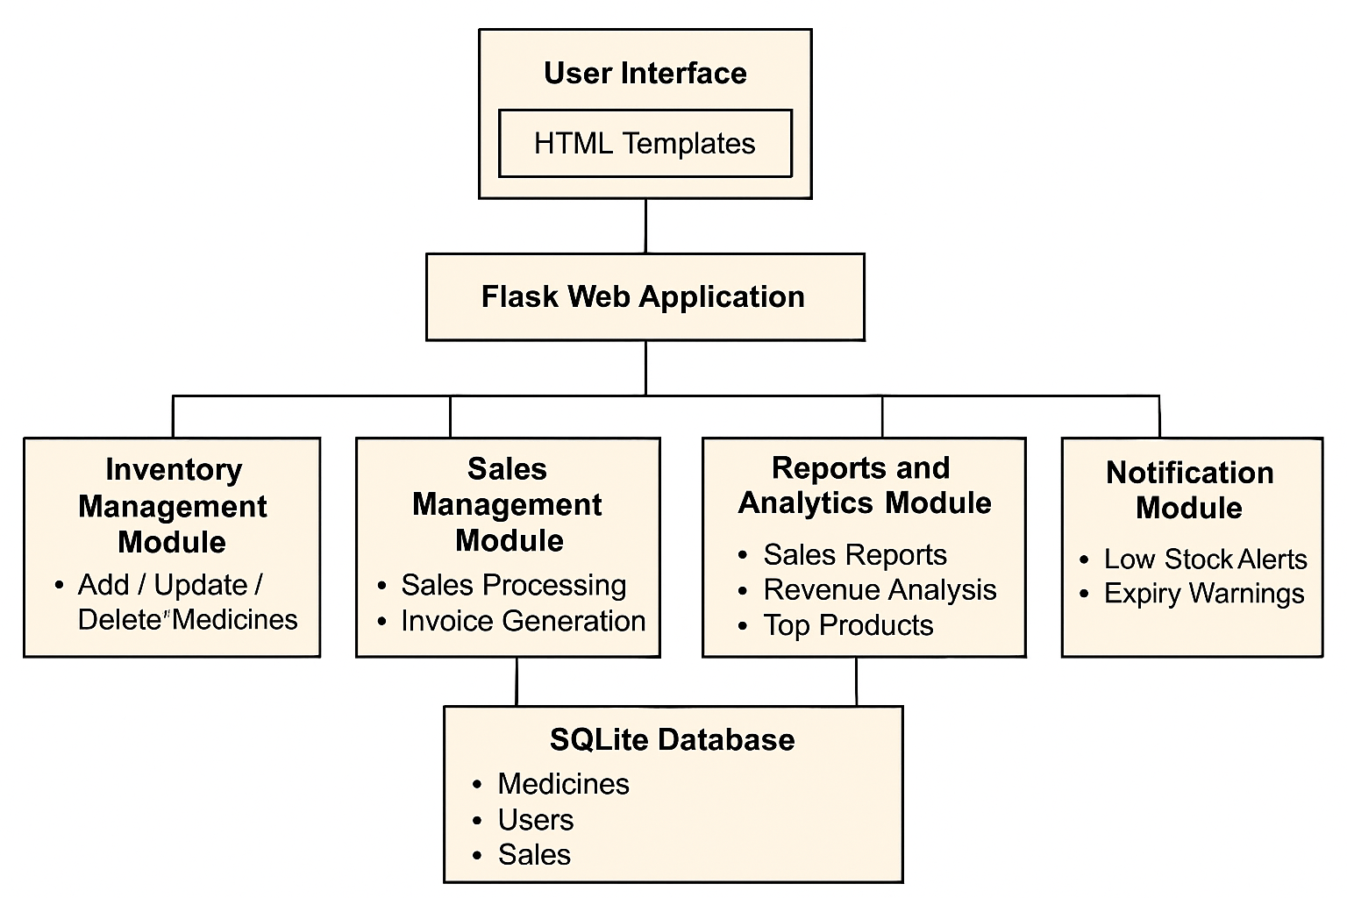
System Deployment
Deployment Diagram
Component Diagram
Shows physical infrastructure and hardware
Illustrates system functional modules
Shows interfaces between components
Maps software components to physical nodes

Slide 5



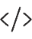


Work Breakdown Structure
Project Planning
Requirements gathering, team setup
Basic System
SRS, UI mockups, Flask initialization
Advanced System
Reporting, sales validation, UI enhancements

Slide 6




Work Division
Mustafa Iqbal (Team Lead)
Amaar Khan (Scrum Master)
Saad Nadeem (Developer)
Oversaw project progress
Organized sprints and retrospectives
Backend and database implementation
Task assignment and monitoring
Documentation and team facilitation
Medicine management modules

Slide 7
User Stories
User Stories (Main Highlights)
Product Backlog Snippets
User Story | Priority | Status
Add new medicines | High | Planned
Update medicine details | High | Planned
View inventory reports | Medium | Planned
Receive low stock alerts | High | Planned
Process sales and update stock | High | Planned
Track monthly revenue | Medium | Future Sprint
Stock status indicators | Medium | Future Sprint
Medicine categorization | Low | Future Sprint
Expired medicines tracking | Medium | Planned
Pharmacist : ➔ Add new medicines to inventory for stock tracking. ➔ Update medicine details to maintain accurate information. ➔ Create sales records to process purchases and update stock.
Store Manager: ➔ View inventory reports for stock and restocking decisions. ➔ Receive low-stock notifications for timely restocking

Slide 8
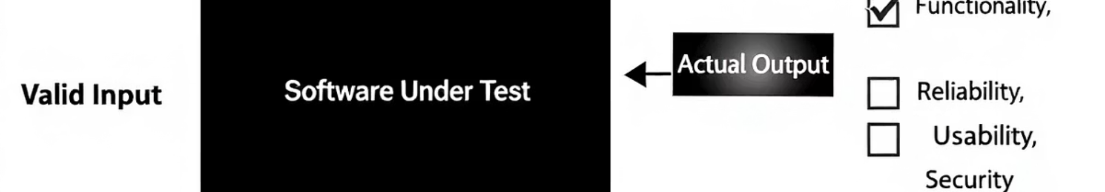
Black Box Testing
Equivalence Class Partitioning (ECP) – Test Cases
Test Case | Input | Expected Output | Status
ECP_TC1 | Medicine Name = "Paracetamol" | Medicine added successfully | Pass
ECP_TC2 | Medicine Name = "" (empty) | Error: Medicine name required | Pass
ECP_TC3 | Price = 10.5 | Medicine added successfully | Pass
ECP_TC4 | Price = -5 | Error: Invalid price | Pass
ECP_TC5 | Wrong Password | Error: Invalid credentials | Pass

Slide 9
Black Box Testing
Boundary Value Analysis (BVA) – Test Cases
Test Case | Input | Expected Output | Status
BVA_TC1 | Quantity < 0 | Error: Must be positive | Pass
BVA_TC2 | Quantity = 0 | Error: Must be positive | Pass
BVA_TC3 | Quantity = 1 | Medicine added successfully | Pass
BVA_TC4 | Quantity = 1000 | Medicine added successfully | Pass
BVA_TC5 | Sale Quantity = 0 | Error: Invalid sale quantity | Pass

Slide 10
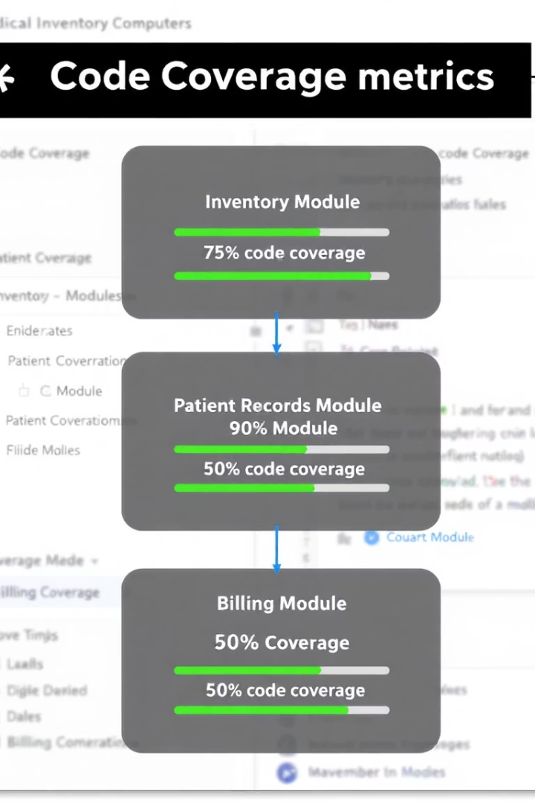
White Box Testing
Test Coverage
87%
83%
Statement Coverage
Branch Coverage
531/609 lines executed
144 branches, 25 partial
89%
Function Coverage
26/29 functions tested
Overall coverage achieved: 87%, generated using pytest-cov

Slide 11





Lessons Learned
Clear Communication
Defined responsibilities avoided delays
Iterative Development
Agile sprints enabled steady progress
Time Management
Prioritization and scheduling skills improved
Version Control
GitHub minimized merge conflicts

